Slide 1
Intro to Analytics
Session-2

Slide 2
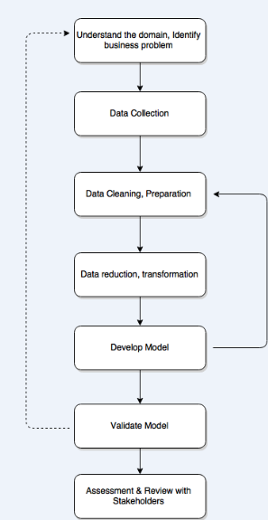
Process To Follow

Slide 3
Business Problem (Question) Framing
The ability to understand a business problem
Obtain or receive problem statement and usability requirements
Identify stakeholders
Refine the problem statement and delineate constraints
Define an initial set of business benefits
Obtain stakeholder agreement on the problem statement

Slide 4
Data
The ability to work effectively with data to help identify potential relationships that will lead to refinement of the business and analytics problem
Identify and prioritize data needs and sources
Acquire data
Harmonize, rescale, clean, and share data
Identify relationships in the data
Document and report findings (e.g., insights, results, business performance)
Refine the business and analytics problem statements

Slide 5
Methodology (Approach) Selection
The ability to identify and select potential approaches for solving the business problem.
Identify available problem solving approaches (methods)
Select software tools
Test approaches (methods)
Select approaches (methods)

Slide 6
Model Building
The ability to identify and build effective model structures to help solve the business problem.
Identify model structures1
Run and evaluate the models
Calibrate models and data
Integrate the models
Document and communicate findings (including assumptions, limitations, and constraints)

Slide 7
Deployment
The ability to deploy the selected model to help solve the business problem
Perform business validation of the model
Deliver report with findings
Create model, usability, and system requirements for production
Deliver production model/system
Support deployment

Slide 8
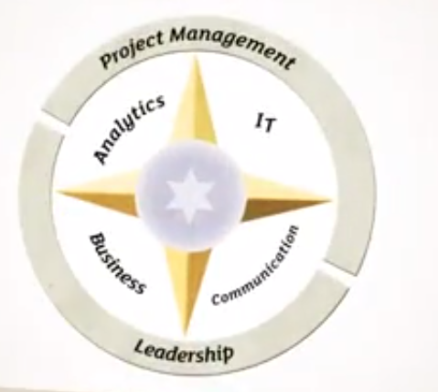
Skills Needed to leverage value from data

Slide 9
Expectations from Data Driven Manager/Analyst
Qualifying the issue in Quantitative terms
Conducting relevant data analyses
Presenting your conclusions and recommendations in a business oriented actionable and efficient way

Slide 10
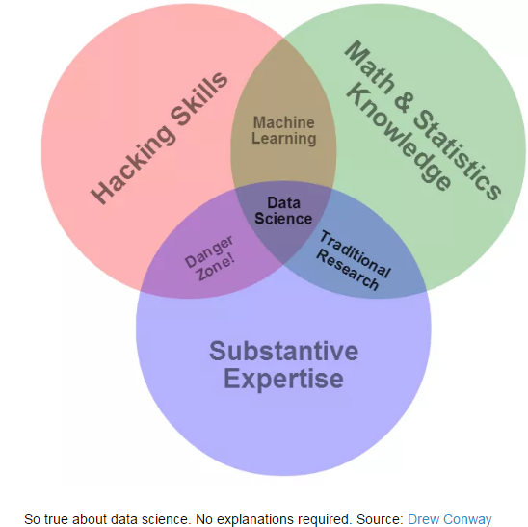
Data Scientist

Slide 11
